Slide 1
New Tank Car Standards and
Operational Controls for High-Hazard Flammable Trains
New Regulatory Requirements Addressed in HM-251 Final Rule
Published May 8, 2015
U.S. Department of Transportation
Federal Railroad Administration

Slide 2
Key Provisions of HM-151
New TC & DOT 117, 117 P and 117R tank car specifications
Special Trains – HFFT and HFFUT
Train Speed
Proof of Classification
Train & Locomotive Safety
Emergency Response
Enhanced Braking
Routing, Notification and Risk Assessments
Taking Higher Risk Tank Cars Out of Service
Scheduling of New Tank Car Implementation

Slide 3
New Tank Car Specs
DOT 117
DOT 117R (Retrofit)
DOT 117P (Performance)

Slide 4
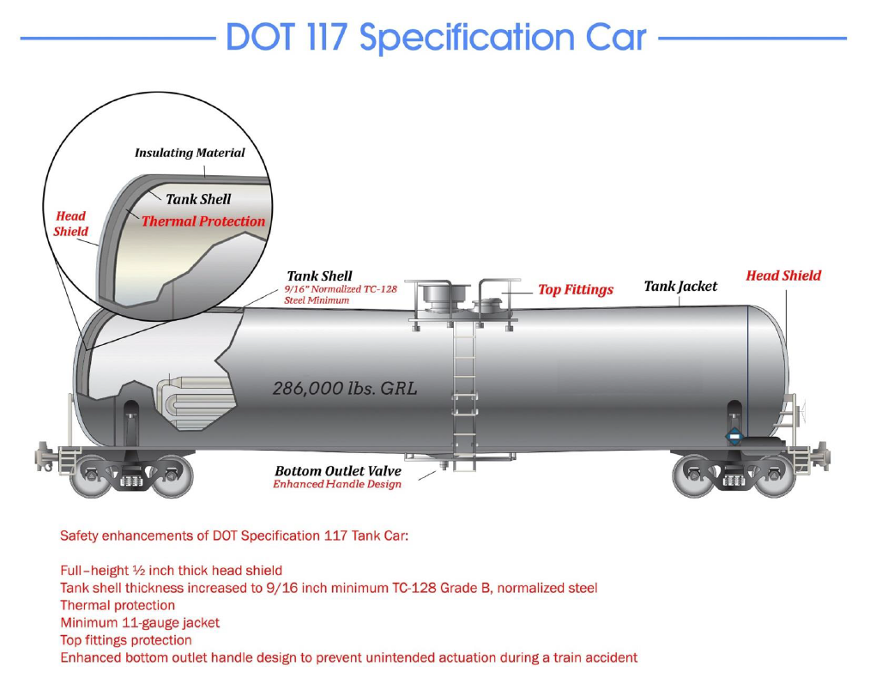
* New tank cars built after 10/1/2015 must meet DOT 117 design or performance criteria

Slide 5
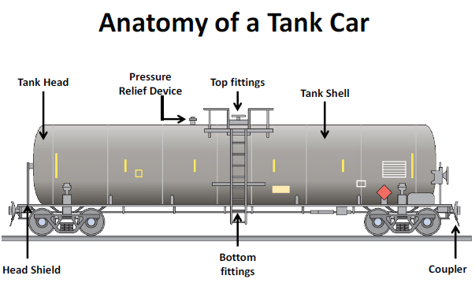
Retrofit Requirements
DOT 117R
  Allows 7/16” shell thickness with steel authorized by regulation at the time of construction.
    Add 11-gauge steel jacket over thermal protection system
  Add ½” Full Head Shield
  Allows top and bottom fittings as equipped at time of construction
  ECP Braking
Upgrade PRV if needed
Bottom valve protections against actuation

Slide 6
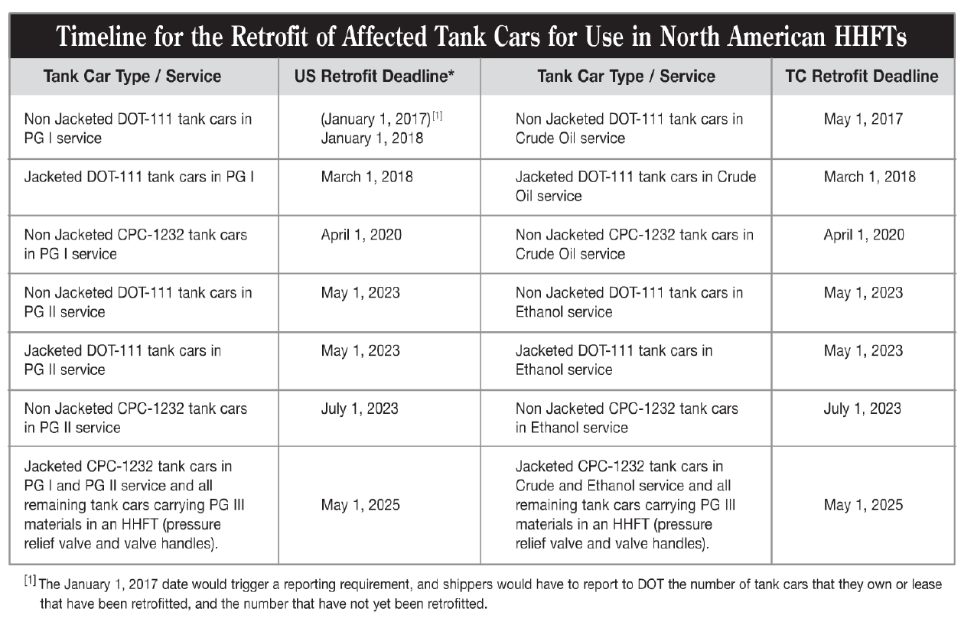
Retrofit Timeline

Slide 7
DOT 117P
Same as the DOT 117 except:
  Shell and jacket thickness could be less provided that it incorporates some type of protection or energy absorption systems on the shell and heads.
  Must be capable of resisting a side impact of 12 mph and a head impact of 18 mph from a 12 x 12 inch impactor weight 286,000 pounds.

Slide 8
Operational Controls
For
High-Hazard
Flammable Trains
(HHFT)

Slide 9
Reduced Operating Speeds
Restrict all HHFTs to 50-mph in all areas
Require HHFTs that contain any tank cars not meeting the enhanced tank car standards required by this rule operate at a 40-mph speed restriction in High-Threat Urban Areas (HTUA)
High Hazard Flammable Liquid Trains – ≥ 20 loaded cars in continuous block or ≥ 35 loaded cars within train | High Hazard Flammable Liquid Unit Trains – ≥ 70 loaded cars within train traveling more than 30 mph

Slide 10
High Threat Urban Areas (HTUA)*
State | Candidate Urban Area | Geographic Area Captured in the Data Count | Previously Designated Urban Areas Included
Oregon | Portland Area | Portland, Vancouver, and a 10-mile buffer extending from the border of the combined area | Portland, OR
Washington | Seattle Area | Seattle, Bellevue, and a 10-mile buffer extending from the border of the combined area | Seattle, WA
* Defined in 49 CFR 1580.3

Slide 11
More Accurate Classification of Unrefined Petroleum-Based Products
Document sampling and testing program for all unrefined petroleum-based products, such as crude oil
Certify that programs are in place, document the testing and sampling program outcomes, and make information available to DOT personnel upon request

Slide 12
Rail Routing – Risk Assessment
Railroads operating HHFTs would be required to perform a routing analysis that considers, at a minimum, 27 safety and security factors* and select a route based on its findings.
* 49 CFR §172.820
High Hazard Flammable Liquid Trains – ≥ 20 loaded cars in continuous block or ≥ 35 loaded cars within train | High Hazard Flammable Liquid Unit Trains – ≥ 70 loaded cars within train traveling more than 30 mph

Slide 13
THE SAFETY AND SECURITY
RISK ANALYSIS
1. Volume of hazardous material transported;
2. Rail traffic density;
3. Trip length for route;
4. Presence and characteristics of railroad facilities;
5. Track type, class, and maintenance schedule;
6. Track grade and curvature;
7. Presence or absence of signals and train control systems along the route ("dark" versus signaled territory);
8. Presence or absence of wayside hazard detectors;
9. Number and types of grade crossings;
10. Single versus double track territory;
11. Frequency and location of track turnouts;
12. Proximity to iconic targets;
13. Environmentally sensitive or significant areas;
14. Population density along the route;
15. Venues along the route (stations, events, places of congregation);
16. Emergency response capability along the route;
17. Areas of high consequence along the route, including high consequence targets as defined in § 172.820(c);
18. Presence of passenger traffic along route (shared track);
19. Speed of train operations;
20. Proximity to en-route storage or repair facilities;
21. Known threats, including any non-public threat scenarios provided by the Department of Homeland Security or the Department of Transportation for carrier use in the development of the route assessment;
22. Measures in place to address apparent safety and security risks;
23. Availability of practicable alternative routes;
24. Past incidents;
25. Overall times in transit;
26. Training and skill level of crews; and
27. Impact on rail network traffic and congestion.

Slide 14
Transport Canada
Minister Order (MO) 14-01
Require initial risk assessments and periodic updates based on significant change to determine the level of risk associated with each Key Route over which a Key Train is operated by the company, and in such risk assessments:

Slide 15
Transport Canada
Minister Order 14-01
“Key Route” means any track on which, over a period of one year, is carried 10,000 or more loaded tank cars or loaded intermodal portable tanks containing dangerous goods, as defined in the Transportation of Dangerous Goods Act, 1992 or any combination thereof that includes 10,000 or more loaded tank cars and loaded intermodal portable tanks.
"Key Train” means an engine with cars
  that includes one or more loaded tank cars of dangerous goods that are included in Class 2.3, Toxic Gases and of dangerous goods that are toxic by inhalation subject to Special Provision 23 of the Transport of Dangerous Goods Regulations; or
  that includes 20 or more loaded tank cars or loaded intermodal portable tanks containing dangerous goods, as defined in the Transportation of Dangerous Goods Act, 1992 or any combination thereof that includes 20 or more loaded tank cars and loaded intermodal portable tanks.

Slide 16
Transport Canada
Minister Order 14-01
Risk Factors
1. Volume of dangerous goods being transported; 2. Rail traffic density; 3. Trip length for route; 4. Presence and characteristics of railroad facilities; 5. Track type, class, and maintenance schedule; 6. Track grade and curvature; 7. Presence or absence of signals and train control systems along the route (“dark” versus signaled territory); 8. Presence or absence of wayside hazard detectors; 9. Number and types of grade crossings; 10. Single versus double track territory; 11. Frequency and location of track turnouts; 12. Proximity to iconic targets and natural hazards; 13. Environmentally sensitive or significant areas; 14. Population density along the route; | 15. Venues along the route (stations, events, places of congregation); 16. Emergency response capability along the route; 17. Areas of high consequence along the route; 18. Presence of passenger traffic along route (shared track); 19. Speed of train operations; 20. Proximity to en-route storage or repair facilities; 21. Known threats, including any non-public threat scenarios; 22. Measures in place to address apparent safety and security risks; 23. Availability of practicable alternative routes; 24. Past incidents; 25. Overall times in transit; 26. Training and skill level of crews; 27. Impact on rail network traffic and congestion; 28. Geohazard

Slide 17
Rail Routing - Notification
Ensures that railroads notify State and/or regional fusion centers, and that State, local and tribal officials who contact a railroad to discuss routing decisions are provided appropriate contact information for the railroad in order to request information related to the routing of hazardous materials through their jurisdictions.

Slide 18
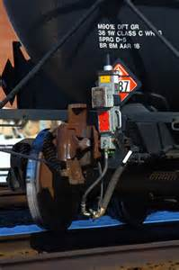
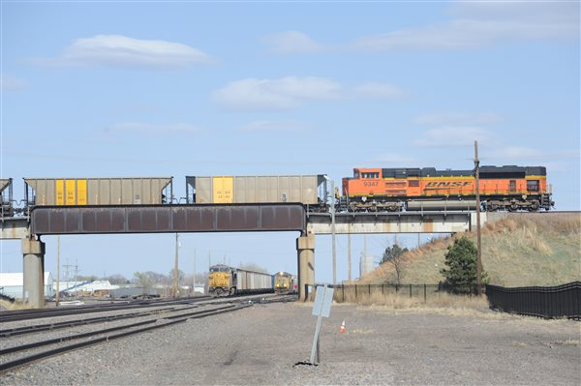
Enhanced Braking
Two way End of Train device
Distributed Power (DP)
Electronically Controlled Pneumatic Brakes

Slide 19
Electronically Controlled Pneumatic (ECP) Braking Schedule
All HHFTs | Must have either EOT or DP braking functionality, speed restricted to 50 mph, 40 mph in HMTUA | Current
HFFUT with 1 or more loaded tank car containing a Class 3 PG I material | Must have ECP braking, or be restricted to 30 mph | Prior to Jan. 1, 2021
All HHFUTs (any Class 3 materials) | Must have ECP braking, or be restricted to 30 mph | Prior to May 1, 2023
High Hazard Flammable Liquid Trains – ≥ 20 loaded cars in continuous block or ≥ 35 loaded cars within train | High Hazard Flammable Liquid Unit Trains – ≥ 70 loaded cars within train traveling more than 30 mph

Slide 20
Enhanced Braking
Require HHFTs to have in place a functioning two-way End of Train (EOT) device or a Distributive Power (DP) braking system
Require any HHFUT transporting at least one PG I flammable liquid be operated with an Electronically Controlled Pneumatic (ECP) braking system by January 1, 2021
Require all other HHFUTs be operated with an ECP braking system by May 1, 2023
High Hazard Flammable Liquid Trains – ≥ 20 loaded cars in continuous block or ≥ 35 loaded cars within train | High Hazard Flammable Liquid Unit Trains – ≥ 70 loaded cars within train traveling more than 30 mph

Slide 21
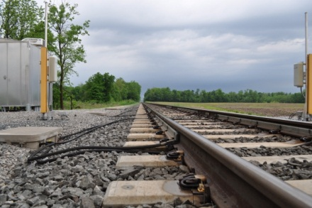
FRA Safety Advisory 2015-01*
Recommends railroads continue to install Wheel Impact Load Detectors (WILDs) along routes used by HHFTs and lower the thresholds for actions to be taken when impacts are detected by WILDs in accordance with guidelines recommended by FRA
Recommends that HHFTs that travel long distances should have mechanical and brake inspections conducted by “qualified mechanical inspectors”.
* Published in FR on April 27, 2015

Slide 22
Taking Higher Risk Tank Cars
Out of Service
Transport Canada’s Protective Direction No. 34*
  Removes older Class 111 and AAR 211 tank cars from dangerous goods service in Canada.
  Made of ASTM A515 steel which poses a higher risk of failure, particularly under cold weather conditions.
  U.S. DOT not taking similar regulatory action.
* April 23, 2014

Slide 23
T
h
a
n
k
Y
o
u
!!!

