Slide 1
49 CFR Part 213 Subpart F: Inspection
Ryan Salinas, Railroad Safety Inspector (Track)
Federal Railroad Administration

Slide 2
49 CFR Part 213 Subpart F
49 CFR Part 213 Subpart F: Inspection
Included in this presentation

Slide 3
49 CFR Part 213 Subpart F
49 CFR Part 213 Subpart F: Inspection
Included in this presentation
§ 213.231 Scope

Slide 4
49 CFR Part 213 Subpart F
49 CFR Part 213 Subpart F: Inspection
Included in this presentation
§ 213.231 Scope
§ 213.233 Visual track inspections

Slide 5
49 CFR Part 213 Subpart F
49 CFR Part 213 Subpart F: Inspection
Included in this presentation
§ 213.231 Scope
§ 213.233 Visual track inspections
§ 213.235 Inspection of switches, track crossings, and lift rail assemblies or other transition devices on moveable bridges

Slide 6
49 CFR Part 213 Subpart F
49 CFR Part 213 Subpart F: Inspection
Included in this presentation
§ 213.231 Scope
§ 213.233 Visual track inspections
§ 213.235 Inspection of switches, track crossings, and lift rail assemblies or other transition devices on moveable bridges
§ 213.239 Special inspections

Slide 7
49 CFR Part 213 Subpart F
49 CFR Part 213 Subpart F: Inspection
Included in this presentation
§ 213.231 Scope
§ 213.233 Visual track inspections
§ 213.235 Inspection of switches, track crossings, and lift rail assemblies or other transition devices on moveable bridges
§ 213.239 Special inspections
§ 213.241 Inspection records

Slide 8
49 CFR Part 213 Subpart F
49 CFR Part 213 Subpart F: Inspection
Not included in this presentation

Slide 9
49 CFR Part 213 Subpart F
49 CFR Part 213 Subpart F: Inspection
Not included in this presentation
§ 213.234 Automated inspection of track constructed with concrete crossties

Slide 10
49 CFR Part 213 Subpart F
49 CFR Part 213 Subpart F: Inspection
Not included in this presentation
§ 213.234 Automated inspection of track constructed with concrete crossties
§ 213.237 Inspection of rail

Slide 11
49 CFR Part 213 Subpart F
49 CFR Part 213 Subpart F: Inspection
Not included in this presentation
§ 213.234 Automated inspection of track constructed with concrete crossties
§ 213.237 Inspection of rail
§ 213.238 Qualified operator

Slide 12
49 CFR Part 213 Subpart F
49 CFR Part 213 Subpart F: Inspection
Not included in this presentation
§ 213.234 Automated inspection of track constructed with concrete crossties
§ 213.237 Inspection of rail
§ 213.238 Qualified operator
§ 213.240 Continuous rail testing

Slide 13
49 CFR Part 213 Subpart F
Example Track Inspection Record

Slide 14
§ 213.231 Scope
Ryan Salinas, Railroad Safety Inspector (Track)
Federal Railroad Administration

Slide 15
§ 213.231 Scope
§ 213.231 Scope
This subpart prescribes requirements for the frequency and manner of inspecting track to detect deviations from the standards prescribed in this part.
* TSS language in Italics

Slide 16
§ 213.233 Visual Track Inspections
Ryan Salinas, Railroad Safety Inspector (Track)
Federal Railroad Administration

Slide 17
§ 213.233 Visual Track Inspections
§ 213.233(a)
All track shall be inspected in accordance with the schedule prescribed in paragraph (c) of this section by a person designated under §213.7.

Slide 18
§ 213.233 Visual Track Inspections
§ 213.233(a)
All track shall be inspected in accordance with the schedule prescribed in paragraph (c) of this section by a person designated under §213.7.
Inspections must be conducted by a person designated under §213.7

Slide 19
§ 213.233 Visual Track Inspections
§ 213.233(a)
All track shall be inspected in accordance with the schedule prescribed in paragraph (c) of this section by a person designated under §213.7.
Inspections must be conducted by a person designated under §213.7
Inspections must be made in accordance with the schedule in paragraph C of this section

Slide 20
§ 213.233 Visual Track Inspections
§ 213.233(b)

Slide 21
§ 213.233 Visual Track Inspections
§ 213.233(b)
Inspections shall be made:

Slide 22
§ 213.233 Visual Track Inspections
§ 213.233(b)
Inspections shall be made:
On foot

Slide 23
§ 213.233 Visual Track Inspections
§ 213.233(b)
Inspections can be done
On foot
By traversing the track, at a speed suitable for inspection

Slide 24
§ 213.233 Visual Track Inspections
§ 213.233(b)
Inspections can be done
On foot
By traversing the track, at a speed suitable for inspection
With the option to use additional inspection devices to supplement the inspection

Slide 25
§ 213.233 Visual Track Inspections
§ 213.233(b) (cont.)
If traversing in a vehicle:
Speed may not be more than 5 mph when traversing track crossings and turnouts

Slide 26
§ 213.233 Visual Track Inspections
§ 213.233(b) (cont.)
If traversing in a vehicle:
Speed may not be more than 5 mph when traversing track crossings and turnouts
Inspector determines speed elsewhere based on track conditions

Slide 27
§ 213.233 Visual Track Inspections
§ 213.233(b)(1)
One inspector may inspect up to two tracks at one time:

Slide 28
§ 213.233 Visual Track Inspections
§ 213.233(b)(1)
One inspector may inspect up to two tracks at one time:
Visibility unobstructed

Slide 29
§ 213.233 Visual Track Inspections
§ 213.233(b)(1)
One inspector may inspect up to two tracks at one time:
Visibility unobstructed
Second track centered not more than 30 feet

Slide 30
§ 213.233 Visual Track Inspections
§ 213.233(b)(2)
Two inspectors in one vehicle may inspect four tracks at a time:

Slide 31
§ 213.233 Visual Track Inspections
§ 213.233(b)(2)
Two inspectors in one vehicle may inspect four tracks at a time:
Visibility unobstructed

Slide 32
§ 213.233 Visual Track Inspections
§ 213.233(b)(2)
Two inspectors in one vehicle may inspect four tracks at a time:
Visibility unobstructed
Each track centered not more than 39 feet

Slide 33
§ 213.233 Visual Track Inspections
§ 213.233(b)(3)
Each main track:
Must be traversed or inspected on foot at least once every two weeks

Slide 34
§ 213.233 Visual Track Inspections
§ 213.233(b)(3)
Each siding:
Must be traversed or inspected on foot at least once every month

Slide 35
§ 213.233 Visual Track Inspections
§ 213.233(b)(4)
Track inspection records:
Shall indicate which track(s) are traversed and which are walked

Slide 36
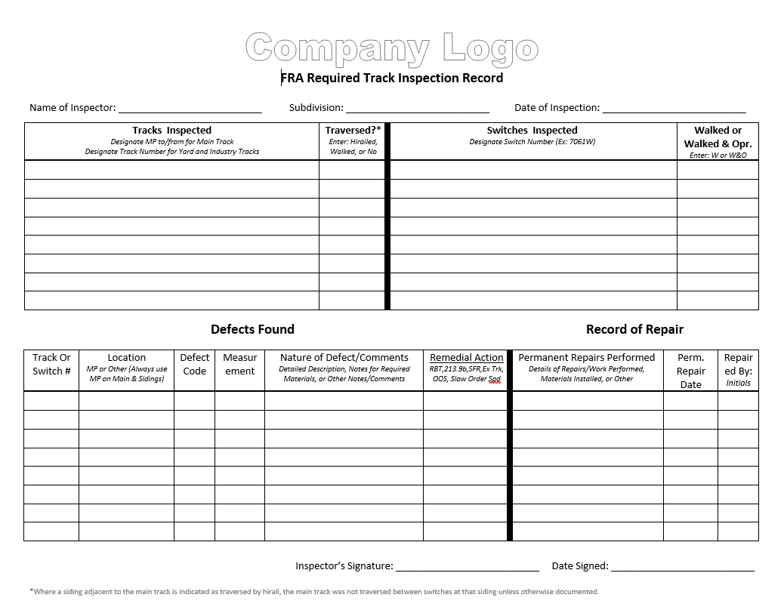
§ 213.233 Visual Track Inspections
§ 213.233(b)(4)
Track inspection records:
Shall indicate which track(s) are traversed and which are walked

Slide 37
§ 213.233 Visual Track Inspections
§ 213.233(c) Inspection Frequency

Slide 38
§ 213.233 Visual Track Inspections
§ 213.233(c) Inspection Frequency
Excepted, Classes 1, 2, 3; Main tacks and sidings:

Slide 39
§ 213.233 Visual Track Inspections
§ 213.233(c) Inspection Frequency
Excepted, Classes 1, 2, 3; Main tacks and sidings:
Weekly, with at least 3 days between inspections

Slide 40
§ 213.233 Visual Track Inspections
§ 213.233(c) Inspection Frequency
Footnote¹

Slide 41
§ 213.233 Visual Track Inspections
§ 213.233(c) Inspection Frequency
Excepted, Classes 1, 2, 3; Main tacks and sidings:
Weekly, with at least 3 days between inspections
If track is used less than once a week, inspect before use

Slide 42
§ 213.233 Visual Track Inspections
§ 213.233(c) Inspection Frequency
Excepted, Classes 1, 2, 3; Main tacks and sidings:
Weekly, with at least 3 days between inspections
If track is used less than once a week, inspect before use
Twice a week, with at least 1 day between inspections, if passengers or more than 10 MGT

Slide 43
§ 213.233 Visual Track Inspections
§ 213.233(c) Inspection Frequency
Footnote²

Slide 44
§ 213.233 Visual Track Inspections
§ 213.233(c) Inspection Frequency
Excepted, Classes 1, 2, 3; Other than main tacks and sidings:

Slide 45
§ 213.233 Visual Track Inspections
§ 213.233(c) Inspection Frequency
Excepted, Classes 1, 2, 3; Other than main tacks and sidings:
Monthly, with at least 20 days between inspections

Slide 46
§ 213.233 Visual Track Inspections
§ 213.233(c) Inspection Frequency
Class 4 and 5 track:
Twice a week, with at least 1 day between inspections

Slide 47
§ 213.233 Visual Track Inspections
§ 213.233(d)
If the § 213.7 qualified person making the inspection finds a deviation from the requirements of this part, the inspector shall immediately initiate remedial action. Any subsequent movements to facilitate repairs on track that is out of service must be authorized by a § 213.7 qualified person.

Slide 48
§ 213.233 Visual Track Inspections
§ 213.233(d)
If the § 213.7 qualified person making the inspection finds a deviation from the requirements of this part, the inspector shall immediately initiate remedial action. Any subsequent movements to facilitate repairs on track that is out of service must be authorized by a § 213.7 qualified person.
Note to §213.233. Except as provided in paragraph (b) of this section, no part of this section will in any way be construed to limit the Inspector’s discretion as it involves inspection speed and sight distance.

Slide 49
§ 213.233 Visual Track Inspections
Fun Fact:
“FRA track inspections do not constitute a required track inspection under the TSS.”
-Compliance manual

Slide 50
§ 213.235 Inspection of switches, track crossings, and lift rail assemblies or other transition devices on movable bridges
Ryan Salinas, Railroad Safety Inspector (Track)
Federal Railroad Administration

Slide 51
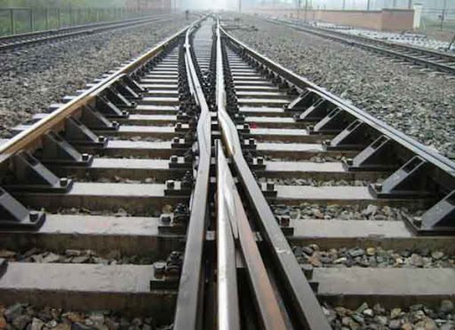
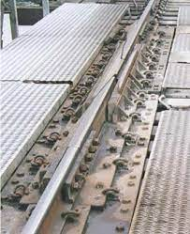
§ 213.235 Inspection of switches, track crossings, etc.
§ 213.235(a)
Except as provided in paragraph (c) of this section, each switch, turnout, track crossing, and moveable bridge lift rail assembly of other transition device shall be inspected on foot at least monthly.

Slide 52
§ 213.235 Inspection of switches, track crossings, etc.
§ 213.235(a)
Except as provided in paragraph (c) of this section, each switch, turnout, track crossing, and moveable bridge lift rail assembly of other transition device shall be inspected on foot at least monthly.
By examining records and conducting field investigations, FRA inspectors can confirm the track owner’s on foot inspection of each switch, turnout, track crossing, and moveable lift bridge rail assembly at least monthly.

Slide 53
§ 213.235 Inspection of switches, track crossings, etc.
§ 213.235(b)
Each switch in Classes 3 through 5 track that is held in position only by the operating mechanism and one connecting rod shall be operated to all of its positions during one inspection in every three month period.

Slide 54
§ 213.235 Inspection of switches, track crossings, etc.
§ 213.235(b)
Each switch in Classes 3 through 5 track that is held in position only by the operating mechanism and one connecting rod shall be operated to all of its positions during one inspection in every three month period.
Compliance Manual Guidance:
Applies to switches held in normal or reverse by only one connecting rod

Slide 55
§ 213.235 Inspection of switches, track crossings, etc.
§ 213.235(b)
Each switch in Classes 3 through 5 track that is held in position only by the operating mechanism and one connecting rod shall be operated to all of its positions during one inspection in every three month period.
Compliance Manual Guidance:
Applies to switches held in normal or reverse by only one connecting rod
Example of a switch with more than one rod: switch with a lock rod

Slide 56
§ 213.235 Inspection of switches, track crossings, etc.
§ 213.235(b)
Each switch in Classes 3 through 5 track that is held in position only by the operating mechanism and one connecting rod shall be operated to all of its positions during one inspection in every three month period.
Compliance Manual Guidance:
Applies to switches held in normal or reverse by only one connecting rod
Example of a switch with more than one rod: switch with a lock rod
Rod connected to a circuit controller does not qualify as a rod that holds a switch in position

Slide 57
§ 213.235 Inspection of switches, track crossings, etc.
§ 213.235(b)
Each switch in Classes 3 through 5 track that is held in position only by the operating mechanism and one connecting rod shall be operated to all of its positions during one inspection in every three month period.
Compliance Manual Guidance:
Applies to switches held in normal or reverse by only one connecting rod
Example of a switch with more than one rod: switch with a lock rod
Rod connected to a circuit controller does not qualify as a rod that holds a switch in position
Requirement is designed to emphasize the importance of these nonredundant mechanisms.

Slide 58
§ 213.235 Inspection of switches, track crossings, etc.
§ 213.235(b)
Each switch in Classes 3 through 5 track that is held in position only by the operating mechanism and one connecting rod shall be operated to all of its positions during one inspection in every three month period.
Compliance Manual Guidance:
Applies to switches held in normal or reverse by only one connecting rod
Example of a switch with more than one rod: switch with a lock rod
Rod connected to a circuit controller does not qualify as a rod that holds a switch in position
Requirement is designed to emphasize the importance of these nonredundant mechanisms.
Thorough inspection is best accomplished by operating the switch mechanism to allow for a comprehensive inspection of these components.

Slide 59
§ 213.235 Inspection of switches, track crossings, etc.
§ 213.235(c)
In the case of track that is used less than once a month, each switch, turnout, track crossing, and moveable bridge lift rail assembly or other transition device shall be inspected on foot before it is used.

Slide 60
§ 213.239 Special Inspections
Ryan Salinas, Railroad Safety Inspector (Track)
Federal Railroad Administration

Slide 61
§ 213.239 Special Inspections

Slide 62
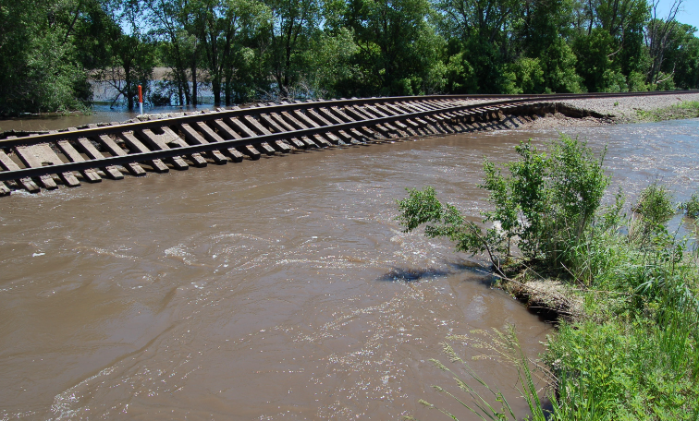
§ 213.239 Special Inspections

Slide 63
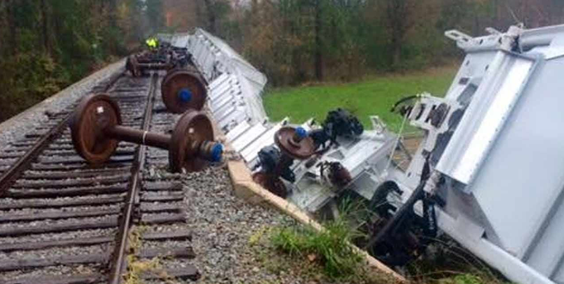
§ 213.239 Special Inspections

Slide 64
§ 213.239 Special Inspections
§ 213.239 Special Inspections
In the event of fire, flood, severe storm, or other occurrence which might have damaged track structure, a special inspection shall be made of the track involved as soon as possible after the occurrence and, if possible, before the operation of any train over that track.

Slide 65
§ 213.239 Special Inspections
§ 213.239 (compliance manual guidance)
Special inspections should be conducted for the primary purpose of determining whether the track structure is safe for the continued operation of trains

Slide 66
§ 213.239 Special Inspections
§ 213.239 (compliance manual guidance)
Special inspections should be conducted for the primary purpose of determining whether the track structure is safe for the continued operation of trains
TSS does not require retention of special inspection records, however, FRA inspectors can look to other sources (e.g. train dispatcher occupancy records) to determine compliance with this regulation

Slide 67
§ 213.241 Inspection Records
Ryan Salinas, Railroad Safety Inspector (Track)
Federal Railroad Administration

Slide 68
§ 213.241 Inspection Records
§ 213.241(a)
Each owner of track to which this part applies shall keep a record of each inspection required to be performed on that track under this subpart.

Slide 69
§ 213.241 Inspection Records
§ 213.241(b)
Track Inspection records shall be:
231(b) Each record of an inspection under §§ 213.4, 213.119, 213.233, and 213.235 shall be prepared on the day the inspection is made and signed or otherwise certified by the person making the inspection. Records shall specify the author of the record, the type of track inspected, date and location of inspection, location and nature of any deviation from the requirements of this part, and the remedial action taken by the person making the inspection. The track owner shall designate the location(s) where each original record shall be maintained for at least one year after the inspection covered by the record. The track owner shall also designate one location, within 100 miles of each State in which it conducts operations, where copies of records that apply to those operations are maintained or can be viewed following 10 days’ notice by the Federal Railroad Administration.

Slide 70
§ 213.241 Inspection Records
§ 213.241(b)
Track Inspection records shall be:
Prepared on the day of the inspection
231(b) Each record of an inspection under §§ 213.4, 213.119, 213.233, and 213.235 shall be prepared on the day the inspection is made and signed or otherwise certified by the person making the inspection. Records shall specify the author of the record, the type of track inspected, date and location of inspection, location and nature of any deviation from the requirements of this part, and the remedial action taken by the person making the inspection. The track owner shall designate the location(s) where each original record shall be maintained for at least one year after the inspection covered by the record. The track owner shall also designate one location, within 100 miles of each State in which it conducts operations, where copies of records that apply to those operations are maintained or can be viewed following 10 days’ notice by the Federal Railroad Administration.

Slide 71
§ 213.241 Inspection Records
§ 213.241(b)
Track Inspection records shall be:
Prepared on the day of the inspection
Signed or certified by the inspector
231(b) Each record of an inspection under §§ 213.4, 213.119, 213.233, and 213.235 shall be prepared on the day the inspection is made and signed or otherwise certified by the person making the inspection. Records shall specify the author of the record, the type of track inspected, date and location of inspection, location and nature of any deviation from the requirements of this part, and the remedial action taken by the person making the inspection. The track owner shall designate the location(s) where each original record shall be maintained for at least one year after the inspection covered by the record. The track owner shall also designate one location, within 100 miles of each State in which it conducts operations, where copies of records that apply to those operations are maintained or can be viewed following 10 days’ notice by the Federal Railroad Administration.

Slide 72
§ 213.241 Inspection Records
§ 213.241(b)
Track Inspection records shall specify:
The author of the record
231(b) Each record of an inspection under §§ 213.4, 213.119, 213.233, and 213.235 shall be prepared on the day the inspection is made and signed or otherwise certified by the person making the inspection. Records shall specify the author of the record, the type of track inspected, date and location of inspection, location and nature of any deviation from the requirements of this part, and the remedial action taken by the person making the inspection. The track owner shall designate the location(s) where each original record shall be maintained for at least one year after the inspection covered by the record. The track owner shall also designate one location, within 100 miles of each State in which it conducts operations, where copies of records that apply to those operations are maintained or can be viewed following 10 days’ notice by the Federal Railroad Administration.

Slide 73
§ 213.241 Inspection Records
§ 213.241(b)
Track Inspection records shall specify:
The author of the record
231(b) Each record of an inspection under §§ 213.4, 213.119, 213.233, and 213.235 shall be prepared on the day the inspection is made and signed or otherwise certified by the person making the inspection. Records shall specify the author of the record, the type of track inspected, date and location of inspection, location and nature of any deviation from the requirements of this part, and the remedial action taken by the person making the inspection. The track owner shall designate the location(s) where each original record shall be maintained for at least one year after the inspection covered by the record. The track owner shall also designate one location, within 100 miles of each State in which it conducts operations, where copies of records that apply to those operations are maintained or can be viewed following 10 days’ notice by the Federal Railroad Administration.

Slide 74
§ 213.241 Inspection Records
§ 213.241(b)
Track Inspection records shall specify:
The author of the record
The type of track inspected
231(b) Each record of an inspection under §§ 213.4, 213.119, 213.233, and 213.235 shall be prepared on the day the inspection is made and signed or otherwise certified by the person making the inspection. Records shall specify the author of the record, the type of track inspected, date and location of inspection, location and nature of any deviation from the requirements of this part, and the remedial action taken by the person making the inspection. The track owner shall designate the location(s) where each original record shall be maintained for at least one year after the inspection covered by the record. The track owner shall also designate one location, within 100 miles of each State in which it conducts operations, where copies of records that apply to those operations are maintained or can be viewed following 10 days’ notice by the Federal Railroad Administration.

Slide 75
§ 213.241 Inspection Records
§ 213.241(b)
Track Inspection records shall specify:
The author of the record
The type of track inspected
231(b) Each record of an inspection under §§ 213.4, 213.119, 213.233, and 213.235 shall be prepared on the day the inspection is made and signed or otherwise certified by the person making the inspection. Records shall specify the author of the record, the type of track inspected, date and location of inspection, location and nature of any deviation from the requirements of this part, and the remedial action taken by the person making the inspection. The track owner shall designate the location(s) where each original record shall be maintained for at least one year after the inspection covered by the record. The track owner shall also designate one location, within 100 miles of each State in which it conducts operations, where copies of records that apply to those operations are maintained or can be viewed following 10 days’ notice by the Federal Railroad Administration.

Slide 76
§ 213.241 Inspection Records
§ 213.241(b)
Track Inspection records shall specify:
The author of the record
The type of track inspected
The date and location of the inspection
231(b) Each record of an inspection under §§ 213.4, 213.119, 213.233, and 213.235 shall be prepared on the day the inspection is made and signed or otherwise certified by the person making the inspection. Records shall specify the author of the record, the type of track inspected, date and location of inspection, location and nature of any deviation from the requirements of this part, and the remedial action taken by the person making the inspection. The track owner shall designate the location(s) where each original record shall be maintained for at least one year after the inspection covered by the record. The track owner shall also designate one location, within 100 miles of each State in which it conducts operations, where copies of records that apply to those operations are maintained or can be viewed following 10 days’ notice by the Federal Railroad Administration.

Slide 77
§ 213.241 Inspection Records
§ 213.241(b)
Track Inspection records shall specify:
The author of the record
The type of track inspected
The date and location of the inspection
231(b) Each record of an inspection under §§ 213.4, 213.119, 213.233, and 213.235 shall be prepared on the day the inspection is made and signed or otherwise certified by the person making the inspection. Records shall specify the author of the record, the type of track inspected, date and location of inspection, location and nature of any deviation from the requirements of this part, and the remedial action taken by the person making the inspection. The track owner shall designate the location(s) where each original record shall be maintained for at least one year after the inspection covered by the record. The track owner shall also designate one location, within 100 miles of each State in which it conducts operations, where copies of records that apply to those operations are maintained or can be viewed following 10 days’ notice by the Federal Railroad Administration.

Slide 78
§ 213.241 Inspection Records
§ 213.241(b)
Track Inspection records shall specify:
The author of the record
The type of track inspected
The date and location of the inspection
Location and nature of any deviations
231(b) Each record of an inspection under §§ 213.4, 213.119, 213.233, and 213.235 shall be prepared on the day the inspection is made and signed or otherwise certified by the person making the inspection. Records shall specify the author of the record, the type of track inspected, date and location of inspection, location and nature of any deviation from the requirements of this part, and the remedial action taken by the person making the inspection. The track owner shall designate the location(s) where each original record shall be maintained for at least one year after the inspection covered by the record. The track owner shall also designate one location, within 100 miles of each State in which it conducts operations, where copies of records that apply to those operations are maintained or can be viewed following 10 days’ notice by the Federal Railroad Administration.

Slide 79
§ 213.241 Inspection Records
§ 213.241(b)
Track Inspection records shall specify:
The author of the record
The type of track inspected
The date and location of the inspection
Location and nature of any deviations
231(b) Each record of an inspection under §§ 213.4, 213.119, 213.233, and 213.235 shall be prepared on the day the inspection is made and signed or otherwise certified by the person making the inspection. Records shall specify the author of the record, the type of track inspected, date and location of inspection, location and nature of any deviation from the requirements of this part, and the remedial action taken by the person making the inspection. The track owner shall designate the location(s) where each original record shall be maintained for at least one year after the inspection covered by the record. The track owner shall also designate one location, within 100 miles of each State in which it conducts operations, where copies of records that apply to those operations are maintained or can be viewed following 10 days’ notice by the Federal Railroad Administration.

Slide 80
§ 213.241 Inspection Records
§ 213.241(b)
Track Inspection records shall specify:
The author of the record
The type of track inspected
The date and location of the inspection
Location and nature of any deviations
Remedial action taken
231(b) Each record of an inspection under §§ 213.4, 213.119, 213.233, and 213.235 shall be prepared on the day the inspection is made and signed or otherwise certified by the person making the inspection. Records shall specify the author of the record, the type of track inspected, date and location of inspection, location and nature of any deviation from the requirements of this part, and the remedial action taken by the person making the inspection. The track owner shall designate the location(s) where each original record shall be maintained for at least one year after the inspection covered by the record. The track owner shall also designate one location, within 100 miles of each State in which it conducts operations, where copies of records that apply to those operations are maintained or can be viewed following 10 days’ notice by the Federal Railroad Administration.

Slide 81
§ 213.241 Inspection Records
§ 213.241(b)
Track Inspection records shall specify:
The author of the record
The type of track inspected
The date and location of the inspection
Location and nature of any deviations
Remedial action taken
231(b) Each record of an inspection under §§ 213.4, 213.119, 213.233, and 213.235 shall be prepared on the day the inspection is made and signed or otherwise certified by the person making the inspection. Records shall specify the author of the record, the type of track inspected, date and location of inspection, location and nature of any deviation from the requirements of this part, and the remedial action taken by the person making the inspection. The track owner shall designate the location(s) where each original record shall be maintained for at least one year after the inspection covered by the record. The track owner shall also designate one location, within 100 miles of each State in which it conducts operations, where copies of records that apply to those operations are maintained or can be viewed following 10 days’ notice by the Federal Railroad Administration.

Slide 82
§ 213.241 Inspection Records
§ 213.241(b)
Track Owner shall:
Designate the location where records are maintained
231(b) Each record of an inspection under §§ 213.4, 213.119, 213.233, and 213.235 shall be prepared on the day the inspection is made and signed or otherwise certified by the person making the inspection. Records shall specify the author of the record, the type of track inspected, date and location of inspection, location and nature of any deviation from the requirements of this part, and the remedial action taken by the person making the inspection. The track owner shall designate the location(s) where each original record shall be maintained for at least one year after the inspection covered by the record. The track owner shall also designate one location, within 100 miles of each State in which it conducts operations, where copies of records that apply to those operations are maintained or can be viewed following 10 days’ notice by the Federal Railroad Administration.

Slide 83
§ 213.241 Inspection Records
§ 213.241(b)
Track Owner shall:
Designate the location where records are maintained
Maintain the records for at least one year after the inspection
231(b) Each record of an inspection under §§ 213.4, 213.119, 213.233, and 213.235 shall be prepared on the day the inspection is made and signed or otherwise certified by the person making the inspection. Records shall specify the author of the record, the type of track inspected, date and location of inspection, location and nature of any deviation from the requirements of this part, and the remedial action taken by the person making the inspection. The track owner shall designate the location(s) where each original record shall be maintained for at least one year after the inspection covered by the record. The track owner shall also designate one location, within 100 miles of each State in which it conducts operations, where copies of records that apply to those operations are maintained or can be viewed following 10 days’ notice by the Federal Railroad Administration.

Slide 84
§ 213.241 Inspection Records
§ 213.241(b)
Track Owner shall:
Designate the location where records are maintained
Maintain the records for at least one year after the inspection
Also designate one location, within 100 miles, where copies can be viewed by FRA following 10 days’ notice
231(b) Each record of an inspection under §§ 213.4, 213.119, 213.233, and 213.235 shall be prepared on the day the inspection is made and signed or otherwise certified by the person making the inspection. Records shall specify the author of the record, the type of track inspected, date and location of inspection, location and nature of any deviation from the requirements of this part, and the remedial action taken by the person making the inspection. The track owner shall designate the location(s) where each original record shall be maintained for at least one year after the inspection covered by the record. The track owner shall also designate one location, within 100 miles of each State in which it conducts operations, where copies of records that apply to those operations are maintained or can be viewed following 10 days’ notice by the Federal Railroad Administration.

Slide 85
§ 213.241 Inspection Records
§ 213.241(h)
Track inspection records shall be kept available to persons who performed the inspections and to persons performing subsequent inspections of the track segment.

Slide 86
§ 213.241 Inspection Records
§ 213.241(h)
Track inspection records shall be kept available to persons who performed the inspections and to persons performing subsequent inspections of the track segment.
§ 213.241(i)
Each track owner required to keep inspection records under this section shall make those records available for inspection and copying by FRA upon request during regular business hours following reasonable notice.

Slide 87
§ 213.241 Inspection Records
§ 213.241(j)
For purposes of complying with the requirements of this section, a track owner may create, retain, transmit, store, and retrieve records by electronic means provided that—

Slide 88
§ 213.241 Inspection Records
§ 213.241(j)
For purposes of complying with the requirements of this section, a track owner may create, retain, transmit, store, and retrieve records by electronic means provided that—
The system used to generate the electronic record meets all requirements and contains the information required under this subpart;

Slide 89
§ 213.241 Inspection Records
§ 213.241(j)
For purposes of complying with the requirements of this section, a track owner may create, retain, transmit, store, and retrieve records by electronic means provided that—
The system used to generate the electronic record meets all requirements and contains the information required under this subpart;
The track owner monitors its electronic records database to ensure record accuracy;

Slide 90
§ 213.241 Inspection Records
§ 213.241(j)
For purposes of complying with the requirements of this section, a track owner may create, retain, transmit, store, and retrieve records by electronic means provided that—
The system used to generate the electronic record meets all requirements and contains the information required under this subpart;
The track owner monitors its electronic records database to ensure record accuracy;
The electronic system is designed to uniquely identify the author of the record. No two persons shall have the same electronic identity;

Slide 91
§ 213.241 Inspection Records
§ 213.241(j)
For purposes of complying with the requirements of this section, a track owner may create, retain, transmit, store, and retrieve records by electronic means provided that—
The system used to generate the electronic record meets all requirements and contains the information required under this subpart;
The track owner monitors its electronic records database to ensure record accuracy;
The electronic system is designed to uniquely identify the author of the record. No two persons shall have the same electronic identity;
The electronic system ensures that each record cannot be modified in any way, or replaced, once the record is completed;

Slide 92
§ 213.241 Inspection Records
§ 213.241(j)
For purposes of complying with the requirements of this section, a track owner may create, retain, transmit, store, and retrieve records by electronic means provided that—
The system used to generate the electronic record meets all requirements and contains the information required under this subpart;
The track owner monitors its electronic records database to ensure record accuracy;
The electronic system is designed to uniquely identify the author of the record. No two persons shall have the same electronic identity;
The electronic system ensures that each record cannot be modified in any way, or replaced, once the record is completed;
The electronic storage of each record shall be initiated by the person making the inspection within 72 hours following the completion of that inspection; and

Slide 93
§ 213.241 Inspection Records
§ 213.241(j)
For purposes of complying with the requirements of this section, a track owner may create, retain, transmit, store, and retrieve records by electronic means provided that—
The system used to generate the electronic record meets all requirements and contains the information required under this subpart;
The track owner monitors its electronic records database to ensure record accuracy;
The electronic system is designed to uniquely identify the author of the record. No two persons shall have the same electronic identity;
The electronic system ensures that each record cannot be modified in any way, or replaced, once the record is completed;
The electronic storage of each record shall be initiated by the person making the inspection within 72 hours following the completion of that inspection; and
Any amendment to a record shall be electronically stored apart from the record which it amends. Each amendment to a record shall be uniquely identified as to the person making the amendment.

Slide 94
49 CFR Part 213 Subpart F
Example Track Inspection Record

Slide 95
49 CFR Part 213 Subpart F
Example Track Inspection Record
Available via .pdf or .doc

Slide 96
What we find during Inspection Records Audits
Ryan Salinas, Railroad Safety Inspector (Track)
Federal Railroad Administration

Slide 97
What we find during Inspection Records Audits
What FRA typically finds during Visual Track Inspection Records Audits

Slide 98
What we find during Inspection Records Audits
What FRA typically finds during Visual Track Inspection Records Audits
Failure to specify the remedial action taken

Slide 99
What we find during Inspection Records Audits
What FRA typically finds during Visual Track Inspection Records Audits
Failure to specify the remedial action taken
Missing assets/no record of inspection

Slide 100
What we find during Inspection Records Audits
What FRA typically finds during Visual Track Inspection Records Audits
Failure to specify the remedial action taken
Missing assets/no record of inspection
Mixing up of defect codes, mileposts, asset names/numbers

Slide 101
What we find during Inspection Records Audits
What FRA typically finds during Visual Track Inspection Records Audits
Failure to specify the remedial action taken
Missing assets/no record of inspection
Mixing up of defect codes, mileposts, asset names/numbers
Not recording defects; inspection records not accurately reflecting track conditions

Slide 102
What we find during Inspection Records Audits
What FRA typically finds during Visual Track Inspection Records Audits
Failure to specify the remedial action taken
Missing assets/no record of inspection
Mixing up of defect codes, mileposts, asset names/numbers
Not recording defects; inspection records not accurately reflecting track conditions
New defect code: 213.241 B13 “Track inspection records do not accurately reflect track conditions”

Slide 103
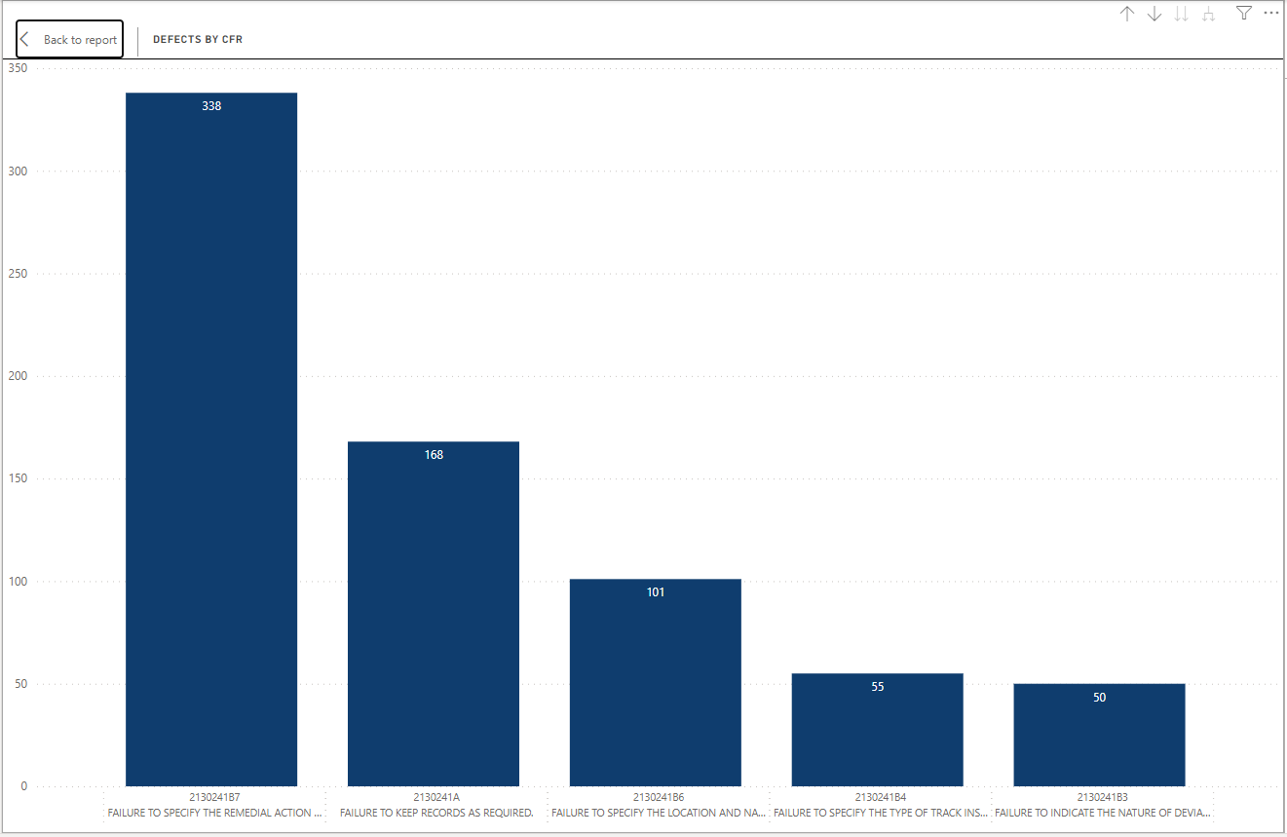
What we find during Inspection Records Audits
2023 FRA Defect Occurrences // § 213.241 Inspection Records // Short-Line RRs
Failure to specify the remedial action taken
49 CFR Part 213.241.B7
338 occurrences
UNCLASSIFIED

Slide 104
What we find during Inspection Records Audits
2023 FRA Defect Occurrences // § 213.241 Inspection Records // Short-Line RRs
Failure to keep records as required 49 CFR Part 213.241.A
168 occurrences
UNCLASSIFIED

Slide 105
What we find during Inspection Records Audits
2023 FRA Defect Occurrences // § 213.241 Inspection Records // Short-Line RRs
Failure to specify the location and nature of deviations found
49 CFR Part 213.241.B6
101 occurrences
UNCLASSIFIED

Slide 106
What we find during Inspection Records Audits
2023 FRA Defect Occurrences // § 213.241 Inspection Records // Short-Line RRs
Failure to specify the type of track inspected
49 CFR Part 213.241.B4
55 occurrences
UNCLASSIFIED

Slide 107
What we find during Inspection Records Audits
2023 FRA Defect Occurrences // § 213.241 Inspection Records // Short-Line RRs
Failure to indicate the nature of deviation
49 CFR Part 213.241.B3
50 occurrences
UNCLASSIFIED

Slide 108
References
National Archives (2024, March 21) Retrieved from Code of Federal Regulations: https://www.ecfr.gov/current/title-49/subtitle-B/chapter-II/part-213/subpart-F
USDOT, FRA (1998, June 22) 49 CFR Track Safety Standards. Federal Register, Docket No.
RST–90 1, Notice No. 8 RIN 2130–AA75.
FRA Form 6180.96 (2023, December 31) Retrieved from Secure Site:
https://safetydata.fra.dot.gov
UNCLASSIFIED

Slide 109
49 CFR Part 213 Subpart F
REMEMBER - Track Inspection Records are an Official Document!

Slide 110
Questions?
Ryan Salinas, Railroad Safety Inspector (Track)
Federal Railroad Administration

Slide 111
Ryan Salinas
Phone: 605-377-8048
Email: ryan.salinas@dot.gov
Todd Anderson
Phone: 701-204-2726
Email: todd.anderson@dot.gov

